Slide 1




 | Dothan Gun Club – Defensive Pistol Course Designer : Drew Coleman
START POSITION :
GUN READY CONDITIONS : |  | SCORED HITS: TARGETS: paper SCORED HITS: Best 2 on paper START-STOP: Audible, last shot NOTES:
STAGE PROCEDURE:
P1

Slide 2
Out & Back NS
Out & Back Target
Drop Out Shoot
Drop Out Shoot
Drop Out Penalty
Drop Out Penalty
Flop-Up
Flop-Up
Can-Can Array
USP2
PP2
USP1
Flop-Up
Flop-Up
PP1
T10
Plate Flop-Up
Plate Flop-Up

Slide 3

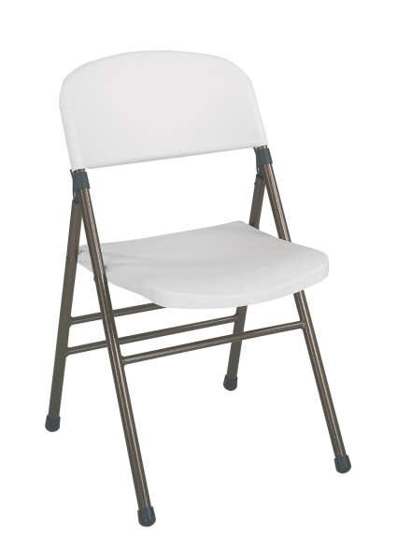
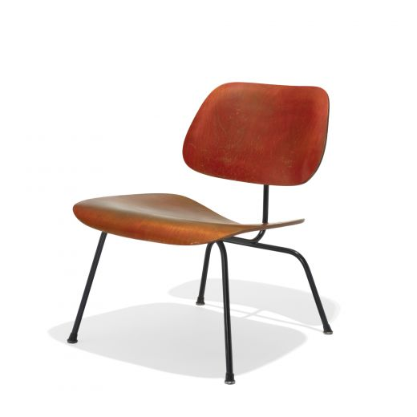


Stage
Desc.
Free Fire Zone

